Slide 1
CHESSGM.X
WEB 3.0 | CHESS DAPP
PLAY 2 EARN STAKE YIELD% PROFIT

Slide 2
CHESSGM.X
THINGS CHESS GM is NOT!
A learning platform
A place to play puzzles
A place to challenge AI
CHESS GM IS
A place where any level of chess player can compete and be rewarded for their engagement
A place where community minded chess players can congregate online

Slide 3
CONCEPT
CHESS GM is focused on hosting virtual chess events (tournaments) in a WEB3.0 PLAY TO EARN environment.
Daily and weekly tournaments (with guaranteed prize pools) gives winning players and place getters the chance achievement rewards in the form of COIN and NFT game assets | collectables.
The CHESS GM DAPP can be accessed as a download browser extension on the BRAVE in a de-centrslised environment.
PLAY TO EARN OPTIONS
Players can earn passive income by winning or placing in daily tournaments and staking their NFT rewards into collections
DAPP investment - Earn governance | voting rights | influence the direction on the community (long term)
INITIAL AIR DROP Free Airdrop NFTS to chess player friends | Become a pioneer player for huge future rewards – Get ahead of the game!
COMPETITION | BENCHMARKS
RIGID CHESS (STEAM)*too much shit going on
IMMORTAL on IMMUTIBLE X https://www.immutable.com/blog/immortal-game-partner-profile
RADICAL CHESS https://radicalchess.com/

Slide 4
TOKEN | COIN | ID
C-GMX Coin = In game coin utility – buy in / out – buy / sell market place / Merch
C-GMT Token = Governance Utility token | playing community stakeholders | governance incentives | contributors
NFT = Representative value in community staking pools and game eco-system
ID = (your name).chessgm.x
Unstoppable Domain Utility - https://www.youtube.com/watch?v=WsYXdIDzLas

Slide 5
TOURNAMENTS
DAILY TOURNAMENT Structure
4 x daily tournament per time zone – ASIA, USA and EUROPE – Limited to 128 players per tournament
Guaranteed prize pool – 32 NFT rewards (top 32 finishes)
32 pieces on a chess board – COLLECT a full set + STAKE for passive income
Low Entry Fees – Entry Fee aligned with NFT collection
Example:
Round of 16 = 1 standard collection
Last 8 = 1 limited collection
Semi = 1 exclusive collection
Runner up = 1 rare collection
Winner = 1 Ultra rare collection
PHASES 2
Higher valued weekly tournaments

Slide 6
STAKING POOLS
NFT STAKING POOLS (based on collection NFT’s) - FULL COLLECTION = stake CHESS PIECES on board – held in game !D
COLLECTING AND STAKING BASED ON PLAYER MOTIVATIONS – Community minded players stake GMT (IGT) and prize players stake GMX (IGC)
Community members have two staking options that cannot be change until the end of the staking term. Yield options:
In game coin – GMX
SHORT TERM 1 YEAR (boost 1.2)
MEDIUM TERM 2 YEARS (boost 1.4)
LONG TERM 3 YEARS (boost 1.8)
GOV Token – GMT
SHORT TERM 1 YEAR (boost X2.8)
MEDIUM TERM 2 YEARS (boost X5.6)
LONG TERM 3 YEARS (boost X8.9)
Please note: all yield are variable until confirmed by an economic consultant

Slide 7
LIQUIDITY
PIONEER IVESTORS - $$AUD (current budget for development)
Receive complete series collection NFTS | Governance status | CGMT Tokens 3,000,000 (locked) | Staking CGMT Yield
Angelino3000 - Julian McCormack - Nick Hurle – Max
Investment pertains to the Collection series. Each collection series allows acquisition of new investors | contributors | community members. A % royalty share on all NFT CARD packs in the marketplace. Royalty % revenue transferred automatically through the ‘share allocation’ to your chess gm wallet.
GAME IP and Utility Address (chessgm.x) 75% game liquidity – 25% Angelino3000 (short term until the game further develops streams of revenue)
CHESS GM ’the game’ is owned per say by a community of governors and a community of players with voting status
PLAYER ADOPTION (liquidity)
DISCORD MARKETING
Paid and/or Referral program via: PIONEER PLAYERS | INFLUENCERS | SOCIAL MEDIA CONTENT | ADVERTISING REACH | UD COMMUNITY
PRE-SALE = PIONEER COLLECTIONS (liquidity)
Investment pre-sale in each collection launch to raise ongoing liquidity

Slide 8
TOKENOMICS
CGMX - In Game Token
$1 USD = 1,000.00
In game TAX on transactions (selling % – Trading %)?
Cash out TAX
CGMT – Token | Governance
How to attain governance status? Staking collections
Complete series of collections staked + 1,000,000 in account balance
Voting
Must own have a full series collection | staking governance token
Liquidity
Pre-Sale – Initial NFT offering – liquidity
Connect Meta Mask Wallet - Chessgm.x ID
POS Accept BTC | ETH | MATIC | DAI

Slide 9
Road map
Primary Objectives 12 – 18 months
Develop a new-age chess community in a stable P2E economic environment
Launch market place
Implement influencer by region strategy | Develop community reach across social media platforms
Launch series 2 collections and so on… Each series launch invites new pre-sale investors into that collection
Community engagement initiatives example: development and design competitions
Governance proposals and voting rewards
Limited to 128 players
Long term Objectives
Develop a 3D gaming environment | Launch CHESS GM chess tour by regions | collections series
Create opportunities for chess players to engage in semi-professional tournament circuit by utilizing game passes
Develop a teams competition
Increase number of tournament (based on demand) | Develop online events

Slide 10
CHESSGM.X ADMINISTRATION
Suggestion to employ a remote worker to monitor and administrate online activity. Administration areas:
Game
Website
NFT market
ROLES
MONITORING | ADMIN: TBA
Marketing: Angelino3000
User Experience: Nick
Special Events: Max

Slide 11
MARKETING
MESSAGE
Web3 community chess tournaments

Slide 12
MARKETING
LAUNCH
$50 USD winners prize for a limited time
REFERAL | AFFLIATE PROGRAMS
Options to develop a player referral and affiliate program
Sponsor chess v-loggers
PIONEER PLAYER DRIVE
Discord community connections https://disboard.org/servers/tag/chess
Bonus token upon sign up
CONSUMER
Free entry sign up - 5,000 bonus
$4.99 sign up – receive card pack + 10,000 bonus + chessgm.x ID bonus

Slide 13
MARKETING
SALE | PRE-SALE
FREE AIR DROP to SIGN UP to PIONEER PRE-SALE
A STANDARD PAWN NFT pack - promoted via CGMX website, discord, twitter X, telegram, telegram, whatsapp
AIR drop NFT’s – Card pack purchase - PRE-SALE LIQUID (upon purchase of CHESSGM.X ID)
Pioneer Player Pre-sale $200 USD – NFT collection (premium status with future voting rights) - chessgm.x ID
Pioneer Player Pre-sale $100 USD – NFT collection - chessgm.x ID
Pioneer Player Pre-sale $50.00 USD – NFT collection - chessgm.x ID
Pioneer Player Pre-sale $20.00 USD – NFT collection - chessgm.x ID
Standard – free sign up | Free to play – bonus IGC 4,000
$4.99 sign up – bonus token 9,000 - NFT card pack + chessgm.x ID (once per player)
Buy in game token = $9.99 | $19.99 | $29.99 | $49.00 | $99.99 | $199.00

Slide 14
PLAYER JOURNEY’S
CREATE YOUR ID (unstoppable domain API)
(your name).chessgm.x
Sign up fee (refer to pre-sale)
Sign up coin bonus
Browser App download extension | Brave | Link ID wallet (metamask)
REGISTER FOR A DAILY TOURNAMENT
COLLECT YOUR BONUS
COMPETE Automated round structure – similar to online poker tournament or chess.com tournaments
5 min blitz tournaments
WIN COIN and NFT’s – pocket winnings – Claim your NFT and stake for yield in a collection category

Slide 15
SWAT ANALYSIS
TREATS – ROBOT PLAYERS – CHEATS – SECURITY BREACHES
STRENGTHS
Player incentives | Player adoption due to high engagement online in Chess
New WEB3 chess?
Long term community ownership and development
Community Proposals Long Term vision – TOKEN / GOV COIN – Diverse range of STAKEHOLDERS from players to WEB3 NFT collectors – WEB3 yield
Opportunity for segmented ‘initial offerings’ (early) stages via series collection. Providing opportunity for consumers to develop equity in the game and its assets.
WEAKNESS New kid on the chess block - Market share | market penetration
OPPORTUNITIES WEB3 chess adoption | Chess players WEB3 adoption | Wider community Introduction into WEB3 | Mass cultural shift from WEB2 to WEB3 gaming – Introducing De-cent. Digital Identity (ownership rights) in WEB 3.0 – supply and demand of WEB3 developers
PROVISIONS

Slide 16
NFTS
NFT COLLECTION RELEASES
COLLECTION SERIES (standard, limited, exclusive, rare, ultra rare)
Pioneer
New York City
CHESS GM GAME PASSES AND PIONEER MEMENTOS
Exclusive special event | tournament rewards Pioneer | New York City
COLLECTION TRAITS (CHESS BOARD | PIECES)
Standard =
Exclusive =
Rare =
Ultra rare =

Slide 17
NFT VALUES
PIONEER COLLECTION
Standard +3% YIELD - PAWN = 2 KNIGHT = 6 BISHOP = 6 ROOK = 10 QUEEN = 18 - KINGS | BOARDS = #3,000
Exclusive +5% YIELD - PAWN = 4 KNIGHT = 12 BISHOP = 12 ROOK = 20 QUEEN = 36 - KINGS | BOARDS #2,000
Rare +7% YIELD - PAWN 8 KNIGHT = 24 BISHOP = 24 ROOK = 40 QUEEN = 72 KINGS | BOARDS #1,000
Ultra rare +9% YIELD - PAWN = 16 KNIGHT = 48 BISHOP = 48 ROOK = 80 QUEEN = 144 KINGS | BOARDS #500
Exclusively NFT CARD packs
BOARDS | KINGS - Exclusively for tournament Winners + NFT CARD packs
CHESS GM GAME PASSES – Pioneer | Havana Game Pass 3000 per series
BLOCKCHAIN - POLYGON

Slide 18
IN GAME ENGAGEMENT
Lobby chat | Peer – peer chat - (Push functionality – UD partner)
Positive engagement upon game rewards and milestones
Bonus missions
Play 4 tournaments in a day – 3,000
Play 10 tournaments in a week – 7,000
Play 20 tournament in a series – 14,000
Invite 3 friends – 15,000
3 finals placing (2nd -16nd) – 3 card packs
3 wins in a series = 9 card packs
Create Avatar – 1 card pack

Slide 19
CONSUMER SENTIMENT
Chess players who devote a lot of time to playing chess competitively
Chess players who seek genuine rewards for the time devoted to the game
Chess players with community values (Web3 eco-system)
Web3 asset traders | money chasers | Yield passive income playing chess (GMX)
‘Cash in cash out – buy in – buy out’...
Web3 yield chasers | store of value in community (GMT)
‘one day the token will launch on a DEX’...
Good at chess bad at trading
Good at trading bad at chess (but enjoys playing competitively to improve)
Bad at chess but loves the game and community
Likes being rewarded for there engagement
Collective motivation – Coin Market Cap News headlines ‘Global chess playing community pumps to the MOON!’. Think GAME STOP :D

Slide 20
MARKET PLACE
BTS – Buy, Sell, Trade
NFT card packs in CGMX or USD | EURO | BITCOIN | ETH
Random NFT card pack allocation for sale in game
NFTS = Chess Pieces – Pioneer game pass – Havana game pass – Pioneer memento
$4.99 USD – Limited time for the first 1000 – use promotion upon release of series collection
$9.99 USD - Regular entry point with in game bonuses
$19.99 USD - volume version of $9.99
$49.99 USD – Higher % Exclusive | Rare –in bonuses
$99.99 USD – Higher % Rare | Ultra - in bonuses
In game secondary market Buy, Sell or trade your NFTS

Slide 21
GOVERNANCE THEORY
GOVERNANCE for players based on:
TOKEN HOLDINGS = 3,000,000 + CGMT
FULL COLLECTION STATUS
ENTITLEMENT to propose the following to the community:
Game theory projects
Game tournaments | events
Game eco-system and treasury (between governors)
GOVERNANCE program commences upon:
100,000 + registered users
2,000 + voting status
VOTING
Players who own 3 + collection and staking token

Slide 22
LEAKY BUCKET ASSUMPTION
INVESTORS ACQUISITIONS
New investors via Pre-sale investment in NFT COLLECTION SERIES promoted to the public and player database
PLAYER RETENTION
Affordable pre-sale card packs offered to the public and player database
Affordable entries into tournaments and special events
Community values
Reward for effort | engagement
Opportunity to generate passive income through Chess GM
NEW PLAYER ACQUISITIONS
Free to play | reach marketing via social media platforms | social influencers
Pre-sale drive

Slide 23
WEBSITE
Landing page
All game details | information sections | Road Map | Whitepaper |login | register Chessgm.x ID
GOVERNORS | TEAM – Avatars and backgrounds
Marketplace
Buy | Sell | Trade
Player dashboard
Profile | Avatar | ID address | tournament stats | NFTS Collected | NFTS collection | filled collections | account | marketplace | Stats – W/L/D % – placings | number of tournaments entered
Admin ???
Panel | dashboard | accounts

Slide 24
WEBSITE
TOOLS
WP | ELEMENTOR PRO
SITEGROUND HOSTING
CHESSGM.X (Unstoppable Domain Utility) – integrate UD utility partners
https://unstoppablemarketplace.com/categories?categories=Utilities
Some ideas for logo | branding

Slide 25
NFTS
Free mint on opensea public marketplace? Bulk mint?
Purchase and receive cards packs on website | met-mask wallet
Mint expiry date?
Categories and use of sub-domains to administrate | mint NFTS ?
Category wallets
Standard collection wallet address = spioneer.chessgm.x
Exclusive collection wallet address = expioneer.chessgm.x
Rare collection wallet address = rpioneer.chessgm.x
Ultra-Rare collection wallet address = urpioneer.chessgm.x
Pioneer Game Passes = ppioneer.chessgm.x
New York City Game Pass = nycgpass.chessgm.x

Slide 26
CREATIVE BRIEF
DESIGN OBJECTIVE
Traditional – modern – futurist WEB3 – attractive chess piece
CHESS GM Benchmarks | Competition:
RIGID CHESS (STEAM)*too much shit going on
IMMORTAL on IMMUTIBLE X https://www.immutable.com/blog/immortal-game-partner-profile
RADICAL CHESS https://radicalchess.com/
CHESS GM Point of difference – traditional chess game – Future community ownership DAO potential (value for players long term) – Scheduled tournaments
Chess Gm design Style
UI | UX – Short term 2D gaming environment – with 3D NFTS
BRANDING (refer to website)
Logo – slogan

Slide 27
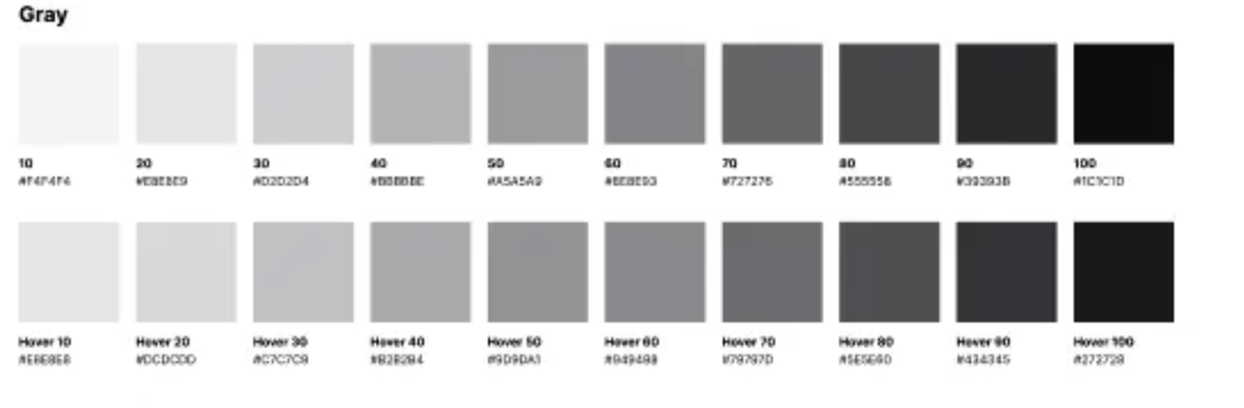
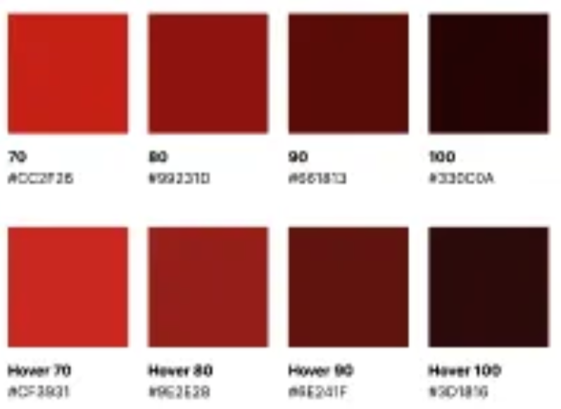
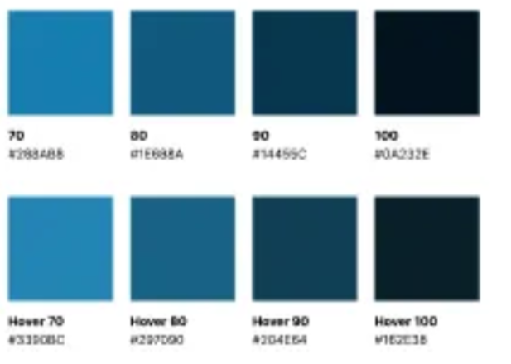
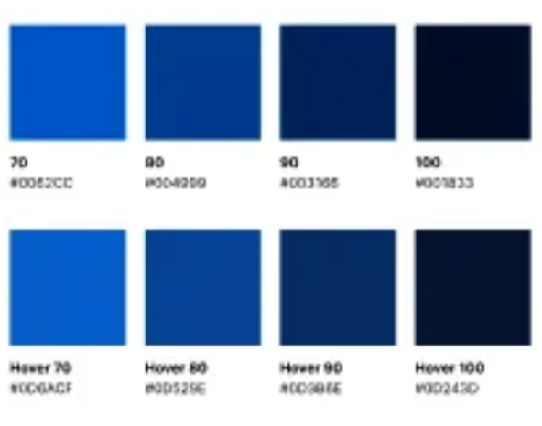
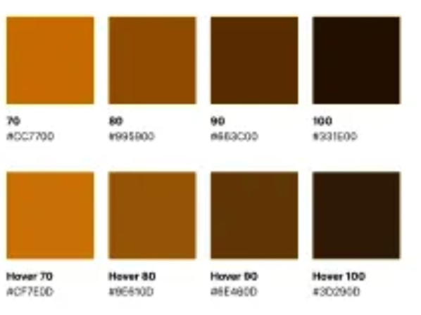
GAME DESIGN | BRANDING STYLE
Modern / futurist / minimal chess in web3 NFT style
Space Grayscale | call to actions | Light and dark mode

Slide 28
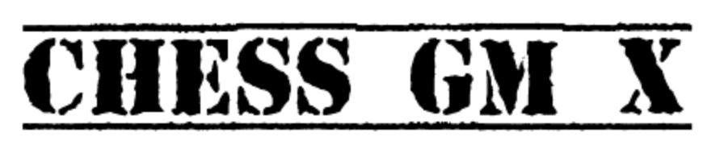
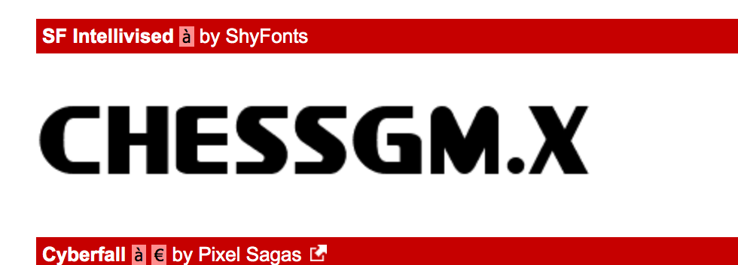
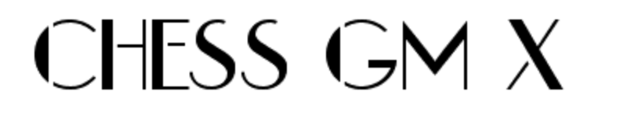



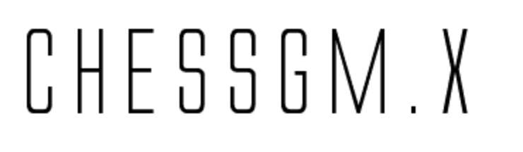




BRANDING STYLE
RANDOM FONT EXAMPLES

Slide 29
UI | UX
Falls in line with branding – Minimal – web3 – modern
TOURNAMENT LOBBY social – UD ID chat function? https://unstoppabledomains.com/blog/categories/announcements/article/messaging-launch
24/7 Lobby chat
POP – UP BROWSER for commencement of automated tournament scheduled games
Info: Players (Avatar) – tournament round (128,64,32,16,Q’s,SF’s and GF - Timer – Head to Head stat
Pre-game countdown clock – game clock – game ends – congratulations animations for winner – commiserations animation for loser – Winner continues to the next phase of the tournament. Browser closes for loser
STAKING PAGE (player profile)
Gallery of NFTS owned – call to action stake NFTS – Gallery of NFTS Collections STAKED
Player profiles - Players can view profiles with stats, owned collections – owned NFTS -

Slide 30
Media Collateral
CHESS GM | CHESSGM.X | CGMX
Logo | Emblem
BRANDING KIT
Online | Merch | Print
Video
Game promo online (30sec) | Tutorial (2-3min)| Chess V-Loggers (1-2 min)
ADS
GIF Banner ads
Win $50 playing chess – FREE TODAY! | Win NFTS playing chess – FREE TODAY

Slide 31
Benchmarks
Chess benchmarks
RIGID CHESS (STEAM)*too much shit going on
IMMORTAL on IMMUTIBLE X https://www.immutable.com/blog/immortal-game-partner-profile
RADICAL CHESS https://radicalchess.com/

Slide 32
WEBSITE
Landing page
All game details (leaderboard | players) | information sections | Road Map | Whitepaper |login | register Chessgm.x ID
GOVERNORS | TEAM – Avatars and backgrounds
Marketplace
Buy | Sell | Trade
Player dashboard
Profile | Avatar | ID address | tournament stats | NFTS Collected | NFTS collection | filled collections | account | marketplace | Stats – W/L/D % – placings | number of tournaments entered
Staking collections information
Admin
Panel | dashboard | accounts

Slide 33
NFTS
PIONEER COLLECTION
3D Marble figurines – rotate POV – 3D printing (option)
STANDARD EXCLUSIVE RARE ULTRA RARE
Design variation from tradition pieces to dynamic designs
FUTURE CITY THEMED COLLECTIONS
New York City
St Petersburg
London
Havana
St. Louis
Moscow
Chennai

